Slide 1




Accessible Machine Learning
in Python
Andreas Müller
Associate Research Scientist
Columbia University
Scikit-learn Technical Committee
Notes:
Hi everybody and thanks for having me. I’ll be speaking on some of my work on accessible machine learning in Python.
A lot of my work is more on the software engineering side, so this talk will be a mixture of some of my research and some of my software engineering work.
Much of my work is on scikit-learn, often via my team. However, that work is often very technical, and so I’m mostly leaving it out of this talk. I don’t think you’re very interested in how we’ve been fighting about if feature names are important and how to preserve them for 4 years.

Slide 2
A real world ML workflow
Data Cleaning
Visualization
Model Building
Data Collection
Integration & Deployment
Model Evaluation
Notes:
I want to start with a quick overview of how I think about the machine learning workflow.
Everybody probably has their own version of this, but still let me walk you briefly talk through mine.
You start with defining the problem you want to solve, and collect the data. You do an initial data cleaning and visualization, then you work on model building and comparison, and do model evaluation.
Then, usually you integrate into a bigger system. That can be deployment or offline use within some bigger pipeline. There’s usually consequences of a model that can not be evaluated without actually using a model.
One of the points I want to emphasize is that this is not a feed-forward process, but there’s a feedback loop between the different steps. I drew it as a cycle but actually I think it’s best to think of it as a fully connected graph. After each step, you might go back to previous steps. Each step might tell you about a mistake you made earlier or something you can do better.
I titled this a real world ML workflow, because this is not how ML is usual treated in research or by existing ML tools.
Usually tools and research focus on a single step, most commonly the model building, and ignore the interdepencencies. I think we need to do better, and that is the focus of this talk.

Slide 3
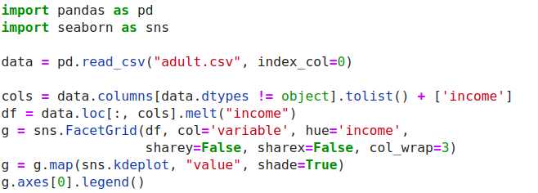
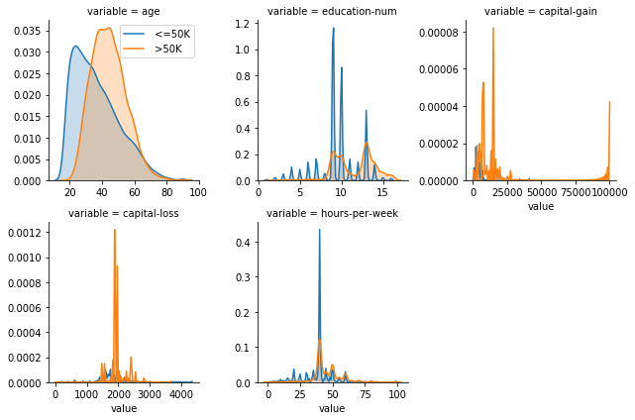
ML with sklearn & pandas
Notes:
Let me be a bit more specific about where I think current tools are lacking. For example, here is me doing some basic visualization on a standard ML benchmark dataset, the adult dataset. I want to figure out what the univariate distributions are for the two classes. I use seaborn which is one of the most advanced visualization libraries for python. However, it’s not really made for supervised learning datasets and so to do what I want to do I have to come up with a pretty intricate call that I think I got by asking Michael Waskom on the issue tracker and that I probably have to look up every time.
And seaborn is great, but it’s not really the tool I need.

Slide 4
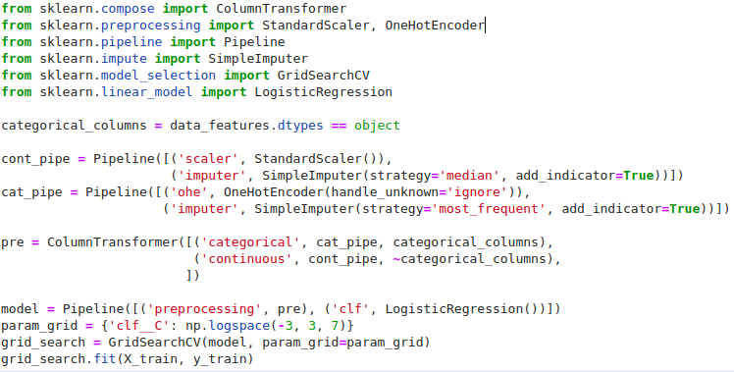
ML with sklearn & pandas
Notes:
Similarly when it comes to machine learning, I think there’s a lot to improve on. I spend a lot of time on scikit-learn and making it easier to use. Here’s basically what you’d have to do to learn a logistic regression model and tune the regularization parameter on this adult dataset. And keep in mind, this is not very dirty data, this is a pretty standard benchmark.
Scikit-learn is very explicit and very flexible which is great when you want to control what you’re doing very precisely. But for running a quick prototype it’s not ideal.
And I can come up with this code here pretty easily but I’m also responsible for a bunch of the things that are happening here. It could certainly be more intuitive.

Slide 5
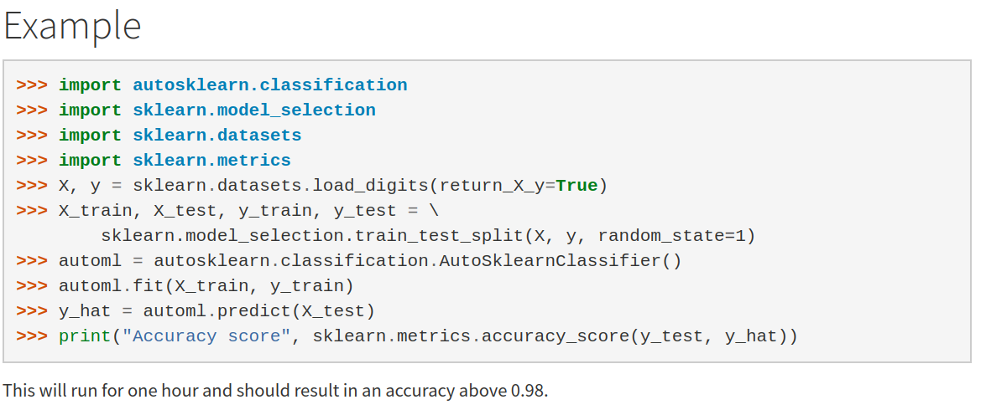
Current Automatic ML frameworks
Notes:
On the other hand you have automatic ML frameworks, like auto-sklearn and teapot and h2o’s automl and many many companies having a service.
There’s a lot of amazing work going on but I think the focus is slightly off.
here’s an example from the auto-sklearn documentation. I love matthias’ work and this is what I’d consider the state of the art implementation.
But their simplest example on a toy dataset that’s shipped with scikit-learn takes about an hour to run. Sure, you get a pretty good model, but this completely kills any interactivity in the model building process.

Slide 6
A real world ML workflow
Data Cleaning
Visualization
Model Building
Data Collection
Integration & Deployment
Model Evaluation
Notes:
Coming back to the workflow I discussed earlier, my point here is not that the tools are bad, but that the tools we have make us focus on the wrong things.
Our tools require us to spend a lot of time on each individual step, and make it hard to iterate quickly between the different stages. In particular our tools make us spend time in the steps that should be easy, like the preprocessing, visualization and modeling. You should be spending time in collecting data and analyzing the model instead.
So let’s talk about what we can do about this situation.
The first thing I want to talk about is some flavors of AutoML that I’ve worked on. That is basically about automating the model building step.

Slide 7
API issues in scikit-learn

Slide 8
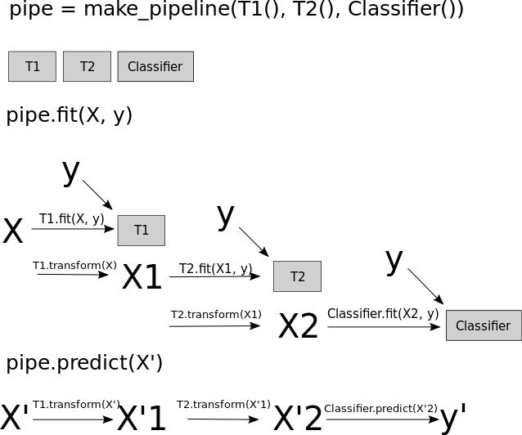

Slide 9
Enabling AutoML Research with OpenML
Notes:
The first thing you need to do automl research is datasets. There’s this great project called OpenML that I joined several years ago.

Slide 10
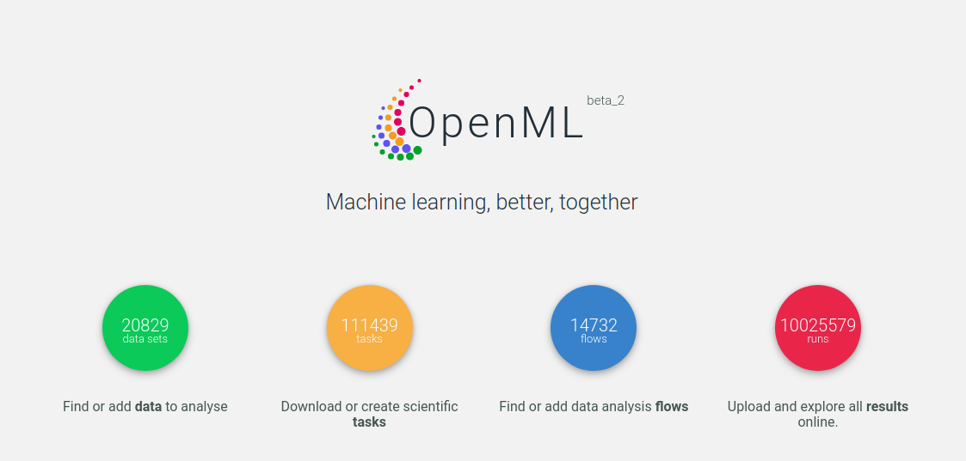
Notes:
Very briefly, openml is an online database of machine learning datasets, together with tasks and evaluation procedures.
So in addition to the dataset, you also have a fixed split of the data, or a fixed set of 10-fold cross-validation folds to make results comparable.
Then, you also have records of the machine learning workflows that people have run on these, and the actual outcome of the runs, which are the predictions and also all kinds of different metrics.
The algorithms are run by the users of openml and uploaded through a set of APIs.

Slide 11
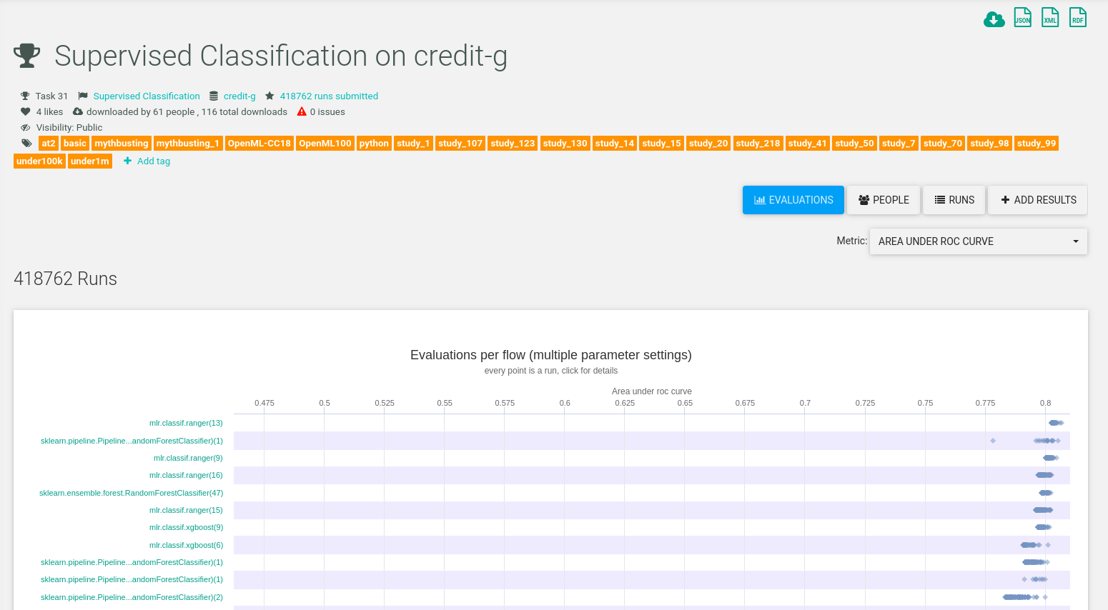
Notes:
Then, for a given task, you can see for example what the top algorithms are, and which hyper-parameters were used.
OpenML was mostly written and is promoted by Joaquin Vanschoren and his PhD student Jan van Rijn, who then did a post-doc with me.

Slide 12
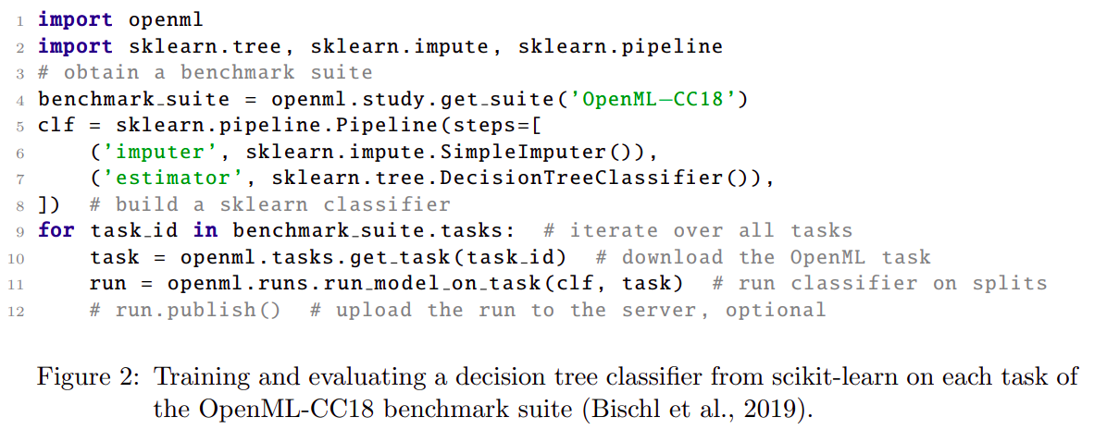
Feurer, Rijn, Kadra, Gijsbers, Mallik, Ravi, Mueller, Vanschoren, Hutter: OpenML-Python: an extensible Python API for OpenML https://arxiv.org/abs/1911.02490 (submitted to JMLR OSS)
Notes:
One of the main aspects of openml that I have contributed to is the python bindings. There are language bindings for openml for Java, python, R and C# as well as a Rest API.
We recently submitted a paper on the Python interface.
It is quite tightly integrated with sklearn and there has been quite a bit of mutual inspiration.
Here in the code you can see the creation of a simple pipeline that uses a decision tree classifier.
Then, this pipeline is run on a whole suite of datasets, the OpenML-CC18.
The CC18 are a collection of 72 datasets that were selected to cover a broad range of classification scenarios, and so ideally, any time you come up with some new supervised learning model and you want to benchmark it, you should use the CC18. With this code here, you can then optionally upload the results to OpenML and make them public.
In the AutoML community, there has been some adoption of these benchmark suits, unfortunately in the broader ML community I haven’t really seen it happen yet and people still cherry-pick their five favorite UCI dataset.

Slide 13
Learning (Multiple) Defaults
Pfisterer, Rijn, Probst, Mueller, Bischl: Learning Multiple Defaults for Machine Learning Algorithms https://arxiv.org/abs/1811.09409
Notes:
Ok, so now we have the tools in place to easily evaluate ML and autoML approaches.
One of the simplest things you can do, which is still surprisingly hard, is learning good defaults.
Right now, in scikit-learn, defaults are basically hand-picked, which is not a good strategy.
Even worse, the tuning grids for a particular model are usually made up on the spot by whoever is doing the tuning. Scikit-learn doesn’t ship any recommendations in a programmatic way.
In this work on learning multiple defaults we tried to make some headway here. The goal is to learn a set of k defaults that is optimum in some sense.

Slide 14
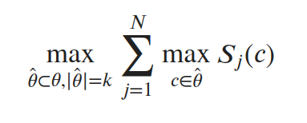
Optimizing a Portfolio of Configurations
Notes:
Here is the definition we worked with. We used a set of datasets, in our case obviously the CC-18.
For now, let’s fix an algorithm, say support vector machines or gradient boosting.
Now we want to find a list of k, say 10 configurations, so that when we try all of them, we have good chances of finding a good one.
We did this with continuous parameter spaces, which makes it a bit more tricky but also allows you to sound very fancy in the paper. But for simplicity just assume we have a discrete set of choices, say by using a grid.
Assume we have 1000 combinations of parameters, which you easily get with a grid. We want to find a subset that is optimum with a given time constraint.

Slide 15
 | Dataset 1 | Dataset 2 | Dataset 3 | Dataset 4 | ...
Configuration 1 | 0.9 | 0.1 | 0.5 | 0.4
Configuration 2 | 0.8 | 0.5 | 0.4 | 0.6
Configuration 3 | 0.4 | 0.9 | 0.3 | 0.1
Configuration 4 | 0.4 | 0.2 | 0.4 | 0.3
...
Notes:
This might sound a bit abstract so I drew a picture. Basically we want to find a subset of the rows in this table so that if you compute the maximum in each column, you’re best on aggregate. Say we aggregate over datasets by using a sum, then we want a subset of k rows so that if I take the maximum over the k rows and then the average over the columns, I get the maximum value.
This is a submodular optimization problem and you can see in a couple of other ways that it’s NP hard to solve correctly. However, we can use a greedy approximation, and that will have a suboptimality of factor 1/2, as usual for submodular maximization.

Slide 16
 | Dataset 1 | Dataset 2 | Dataset 3 | Dataset 4 | ...
Configuration 1 | 0.9 | 0.1 | 0.5 | 0.4
Configuration 2 | 0.8 | 0.5 | 0.4 | 0.6
Configuration 3 | 0.4 | 0.9 | 0.3 | 0.1
Configuration 4 | 0.4 | 0.2 | 0.4 | 0.3
...
Notes:
For the greedy version, we first pick the configuration that’s best on average. That clearly gives us the best subset of size one. This also gives us what should probably be the defaults.

Slide 17
 | Dataset 1 | Dataset 2 | Dataset 3 | Dataset 4 | ...
Configuration 1 | 0.9 | 0.1 | 0.5 | 0.4
Configuration 2 | 0.8 | 0.5 | 0.4 | 0.6
Configuration 3 | 0.4 | 0.9 | 0.3 | 0.1
Configuration 4 | 0.4 | 0.2 | 0.4 | 0.3
...
Notes:
Then, we add the configuration to the set so that adding this row and computing the minimum in the column gives us the highest improvement. So the second row we pick is not the second best, but the one that gives us the biggest advantage over just having the first configuration.
So here in this example, configuration might improve a lot on dataset 2, and so improve the overall set a lot.
One of the benefits of the greedy approximation is that we actually get a ranked list. So if we compute an optimum subset of size k, we get an optimum subset for any value smaller than k.
That’s great for shipping this in software as you only need to ship a single list, and the user can provide the budget.

Slide 18
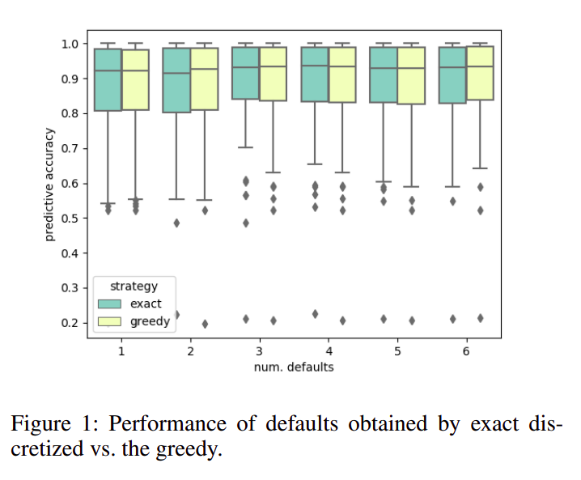
Notes:
We briefly confirmed that using the greedy optimization actually didn’t decrease performance. For this we solved the optimization exactly using branch and bound. We could only do this for relatively small subsets, so here it’s for subsets of size up to 6.

Slide 19
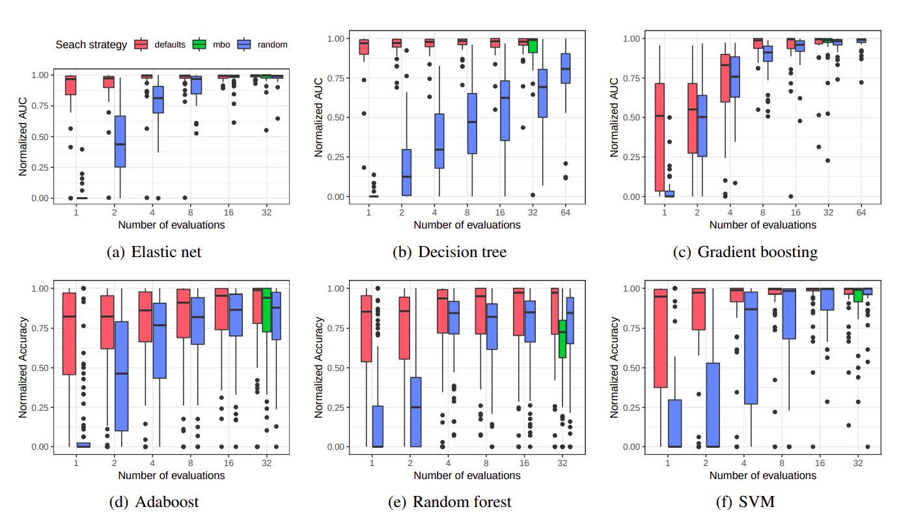
Notes:
Ok so but how well does this actually work? The goal is to provide a solution that can easily be implemented and easily be used. We compared our approach against randomized search and bayesian optimization.
If the budget is very small, say we only allow 2 or 4 runs, then our approach is clearly superior. Bayesian optimization doesn’t really start working until you have 16 or 32 runs or so. However, we found that our ranked list actually performed quite well, even in that regime.
This comparison is a bit apples to oranges, as our algorithm is using meta-learning to produce a fixed list, while the other two are search algorithms that don’t exploit meta-learning. But as a user, what you really care about is performance vs budget, and I think we’re doing quite well.
Another interesting aspect that we didn’t look into is multi-fidelity optimization, or hyperband.
I’ll come back to this later, but basically our approach is orthogonal to hyperband, and once you have your prioritized list, you can just run hyperband or successive halving on it.

Slide 20
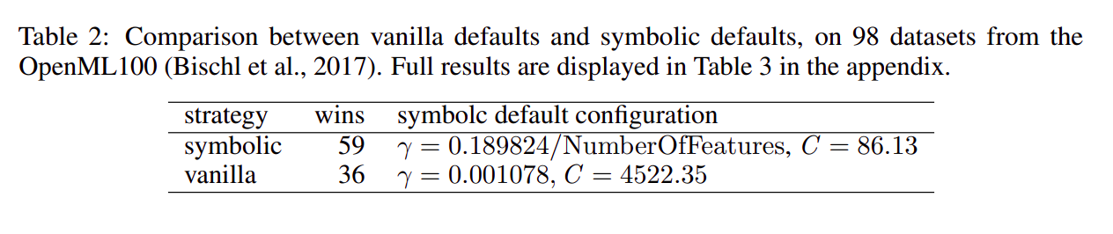
Rijn, Pfisterer, Thomas, Mueller, Bischl, Vanschoren: Meta Learning for Defaults – Symbolic Defaults
NeurIPs Metalearning Workshop 2018
Notes:
We presented an extension of this work at the meta-learning workshop at NeurIPS 2018, were instead of building lists of defaults, we built what we called symbolic defaults.
Here a default is not simply a constant but a simple function of some meta feature. In many cases, scikit-learn and other libraries actually use meta-features to construct defaults. A famous example is the use of the squareroot of the number of features as the max features in a random forest, which is the default that Breiman suggested.
The previous work didn’t do that. In this workshop paper, we didn’t do lists, we just did single defaults. The problem with finding these is that the natural way to do this is genetic programming, and doing genetic programming over the defaults on about 100 datasets is a bit tricky. We could recover some known functional relationships though, such as for the bandwidth of rbf kernels.

Slide 21
data
analysis
baseline
library

Slide 22
dabl.clean
dabl.plot
Data Cleaning
Visualization
Model Building
Data Collection
dabl. AnyClassifier
Model Interpretation
business/science evaluation
dabl.explain
You actually have to think, sorry.

Slide 23
dabl.clean
Detect types
Detect Missing / rare values
Detect ordinal vs categorical
Detect near-constant
Detect index

Slide 24
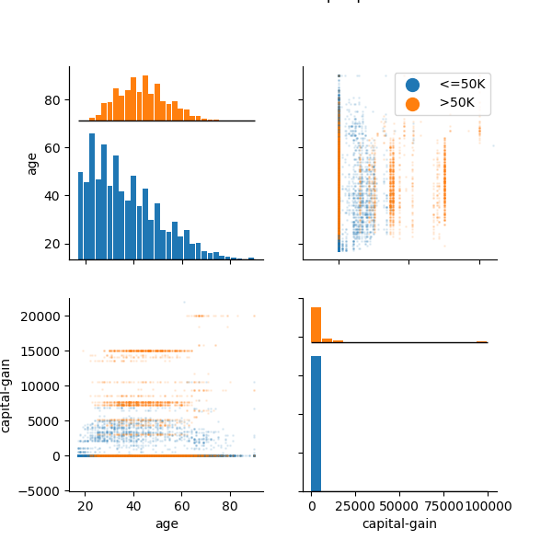
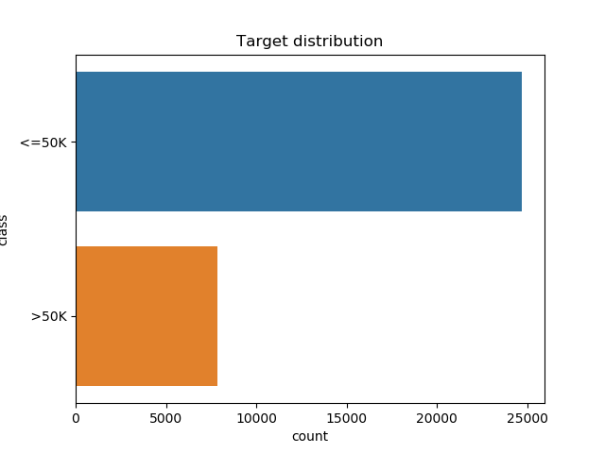
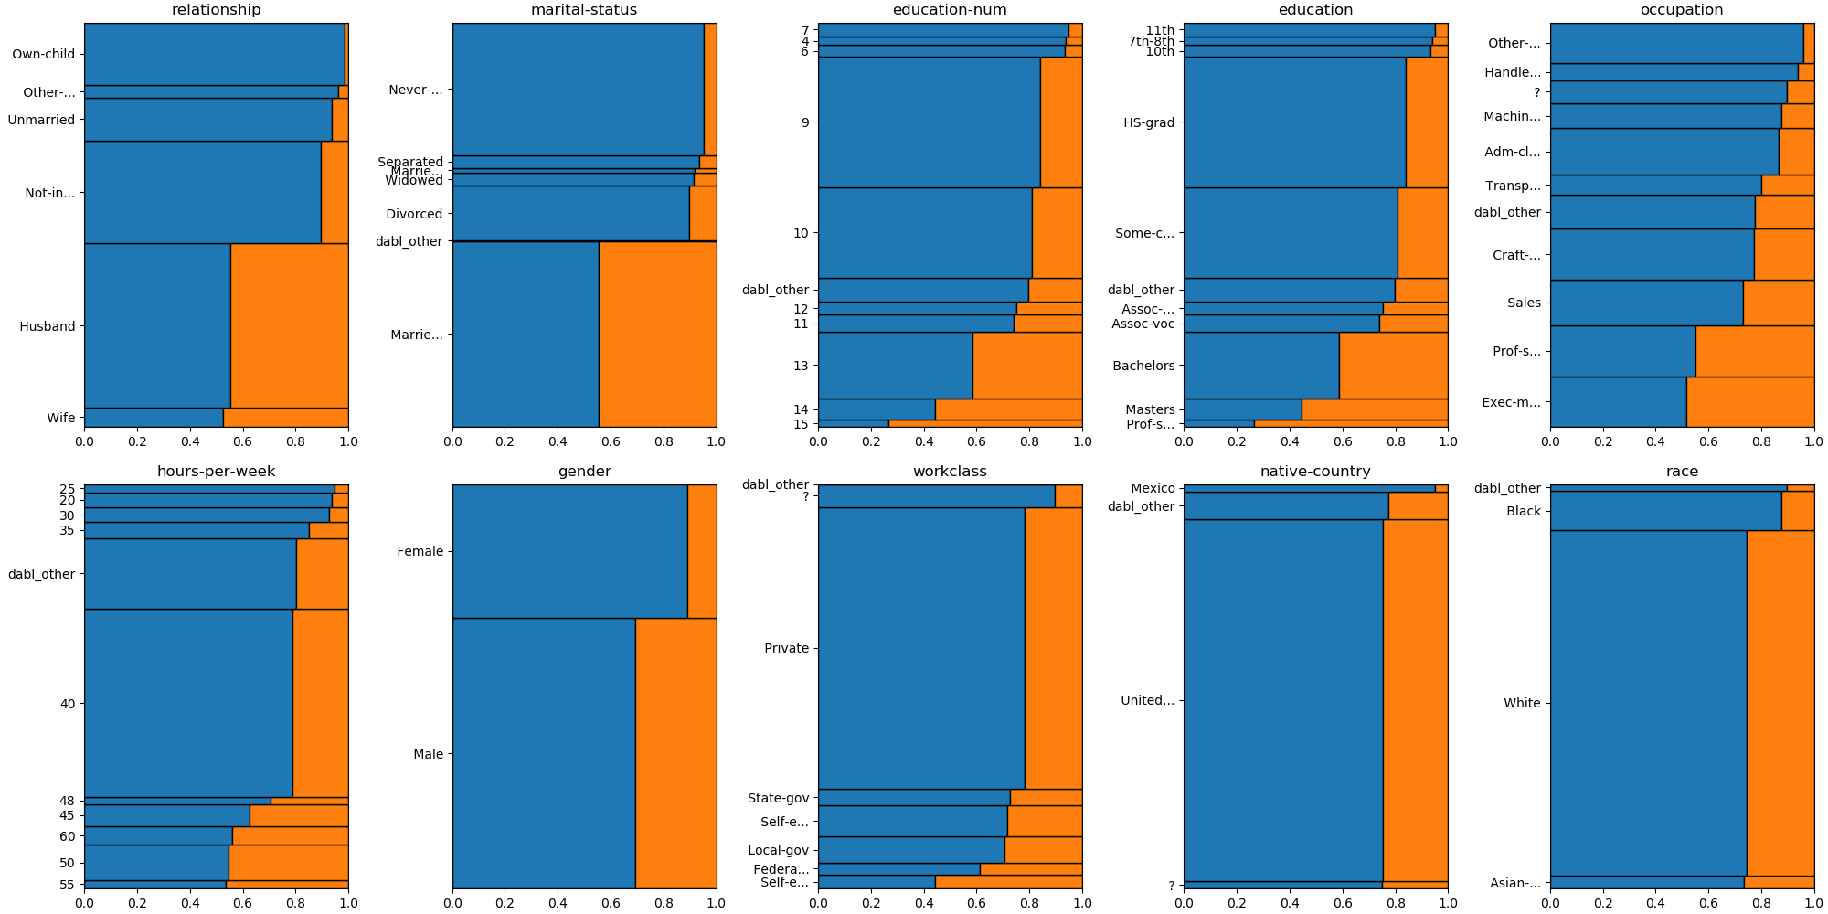
data = pd.read_csv("adult.csv")
plot(data, 'income’)

Slide 25
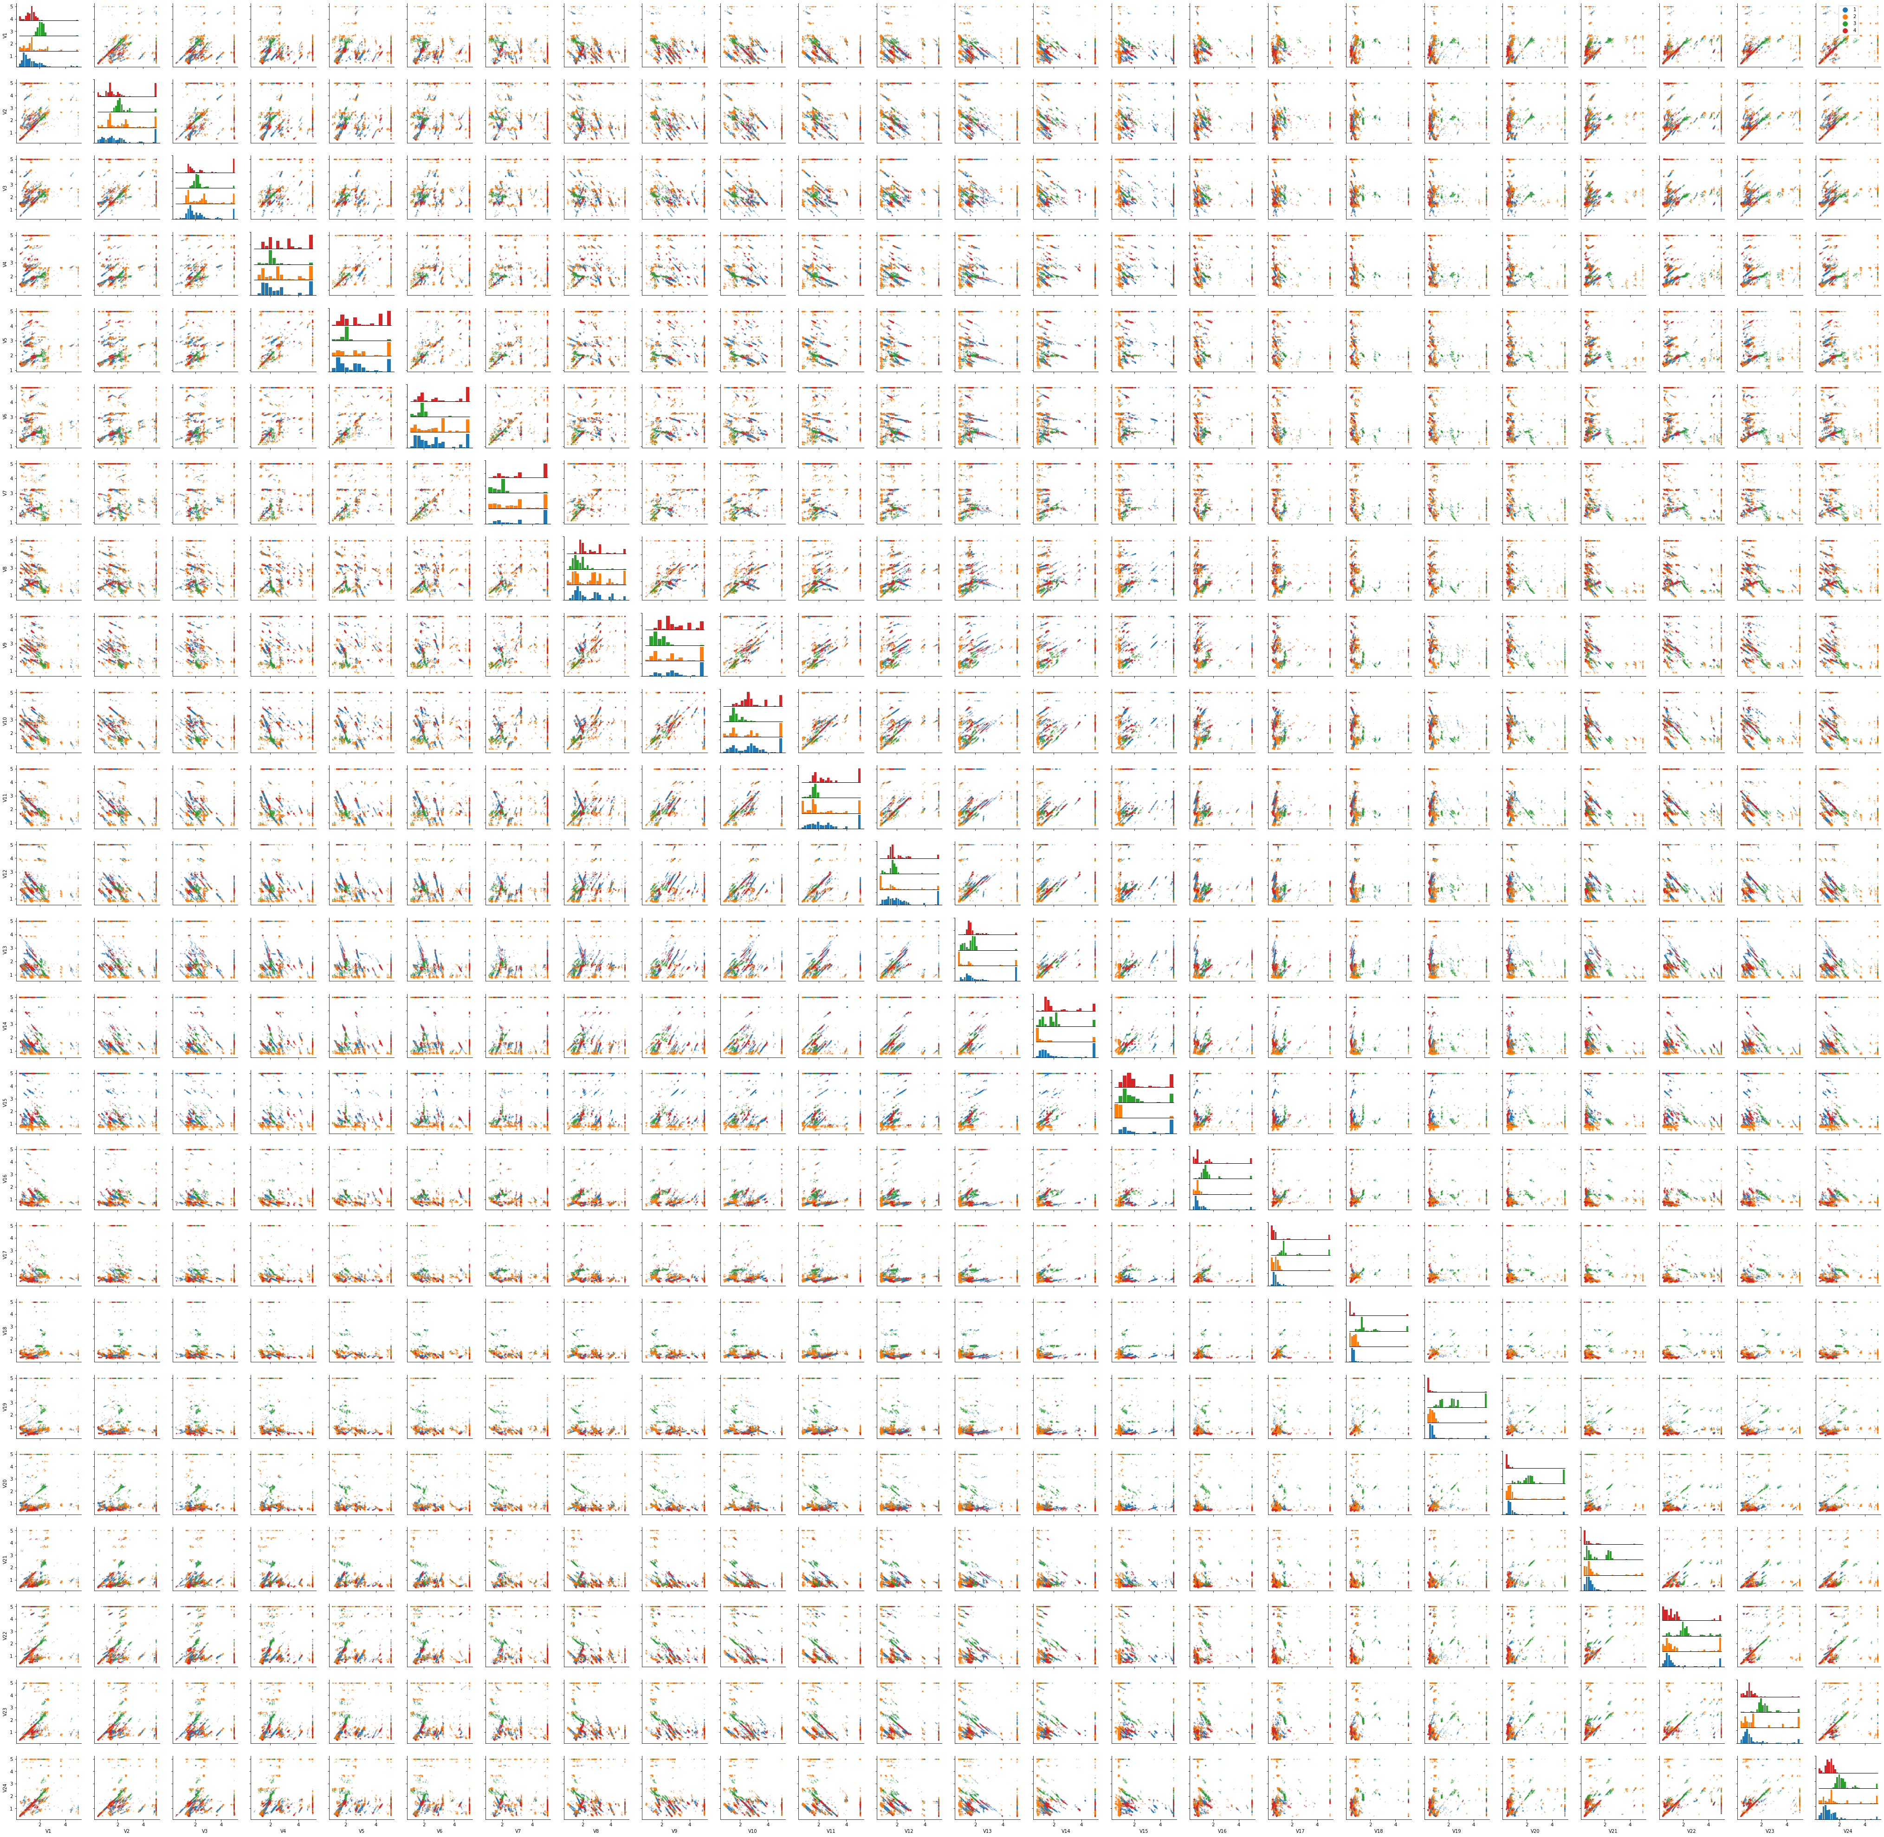
Automatic Scatterplot Selection

Slide 26
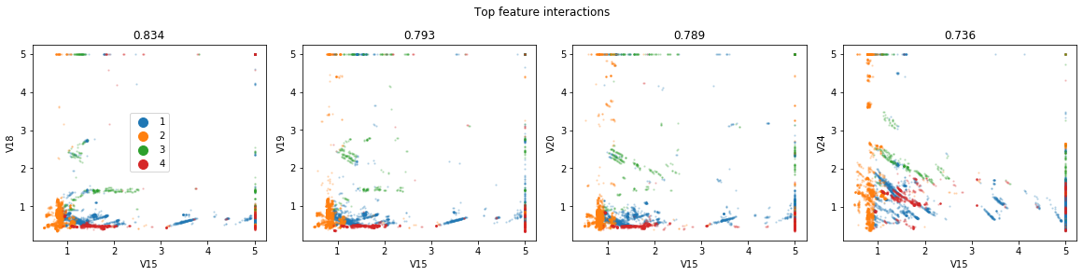
2d Decision Trees as Proxy for Perception
Work in progress: diverse sets of plots

Slide 27
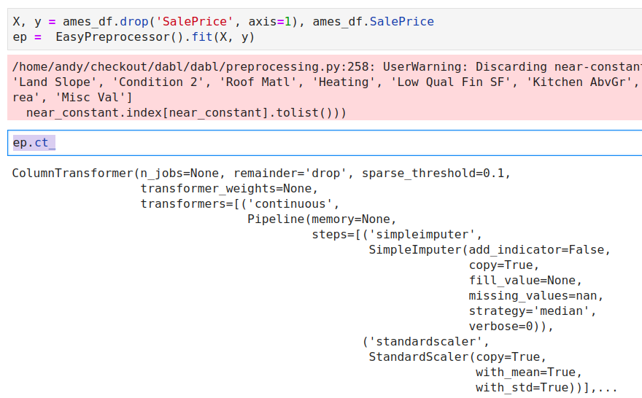
Preprocessing

Slide 28
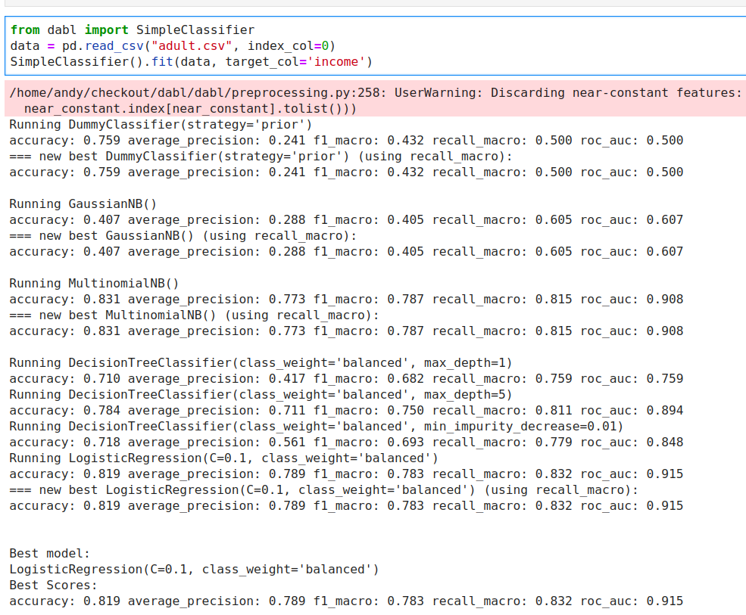

Slide 29
Automatic Model Search

Slide 30
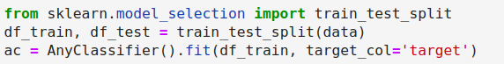
Successive Halving on a fixed, diverse portfolio:

Slide 31

Complex Models
More Linear Models
Random forest
Gradient boosting
Kernel methods

Slide 32
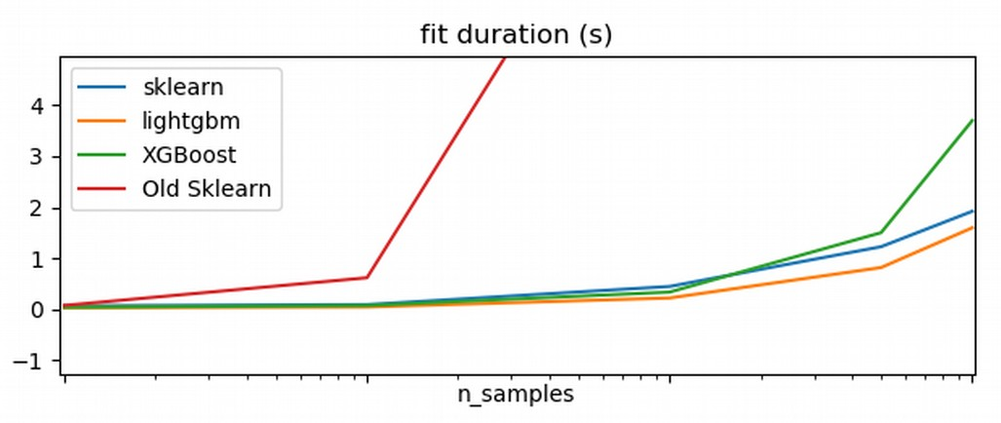

Side note: HistGradientBoosting

Slide 33
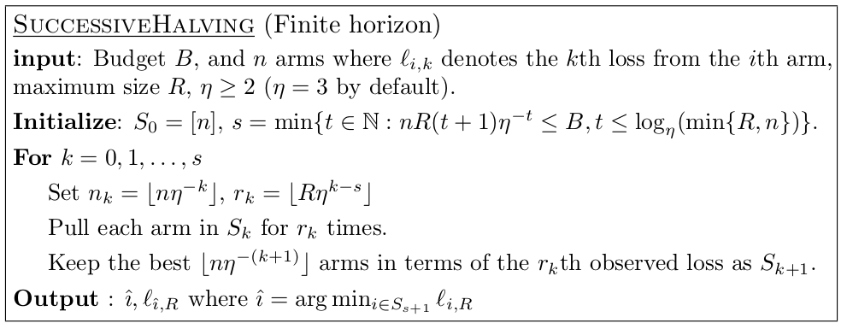
Successive Halving
Given n configuration and budget B
pick η=2 or η=3 (wording follows 2)
Each iteration, keep best halve of configurations
after k=logη(n)+1 left with single configuration.

Slide 34
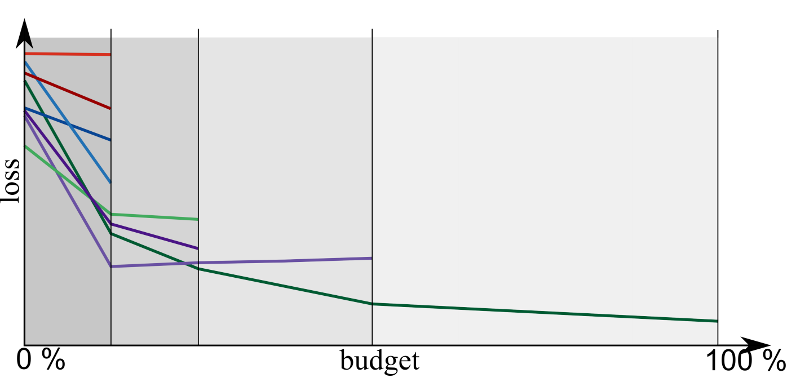
Successive Halving Illustrated

Slide 35
Portfolio creation
Run Hyper-parameter optimization across models on large benchmark suite (OpenML-CC18)
Evaluate all final models across all datasets
Greedily create portfolio of best-performing, diverse models
c.f. “Practical Automated Machine Learning for the AutoML Challenge 2018” Feurer et. al.

Slide 36
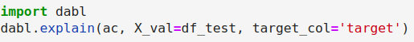

Slide 37
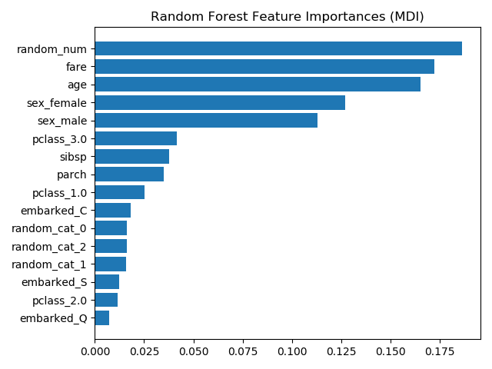
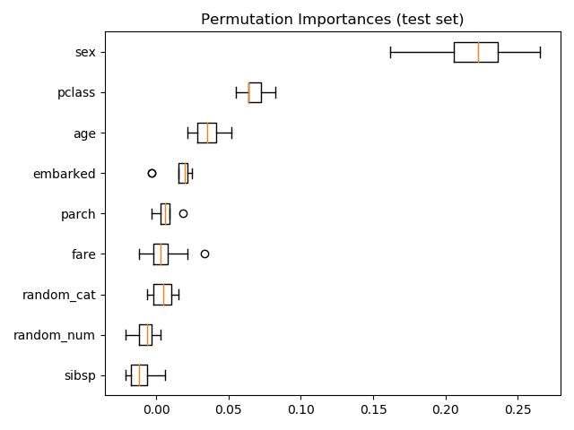
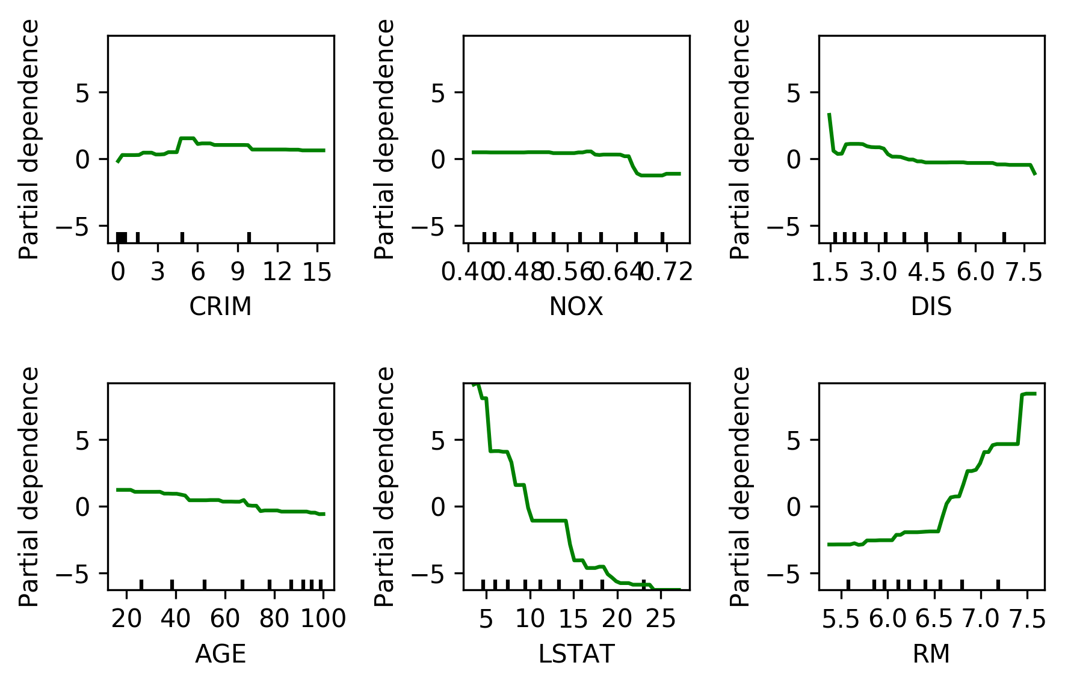
Model Explanation

Slide 38


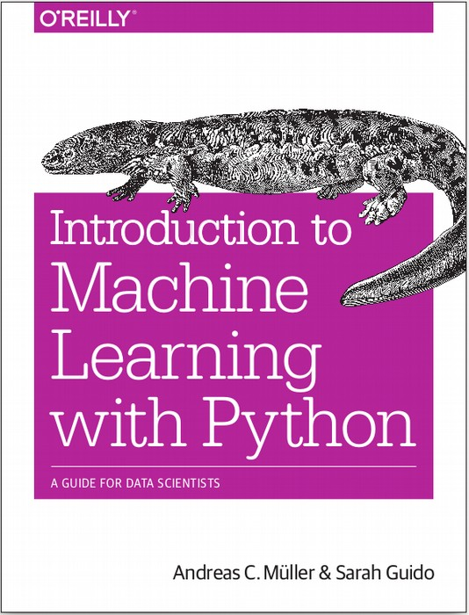


$ pip install dabl
amueller.github.io
@amuellerml
@amueller
andreas.mueller
@columbia.com
https://amueller.github.io/dabl
Notes:
Thank you for your attention and I’m happy to take any questions!

